Slide 1
Smart Bathroom
By Nerds

Slide 2
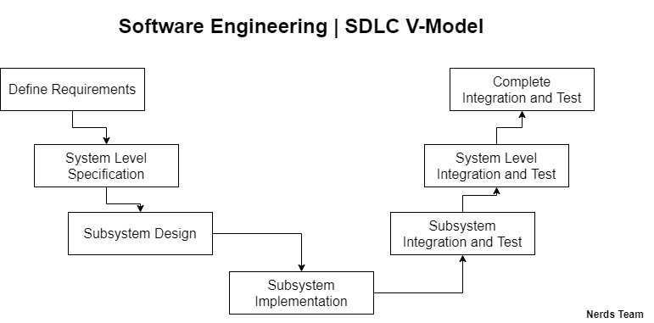

Slide 3
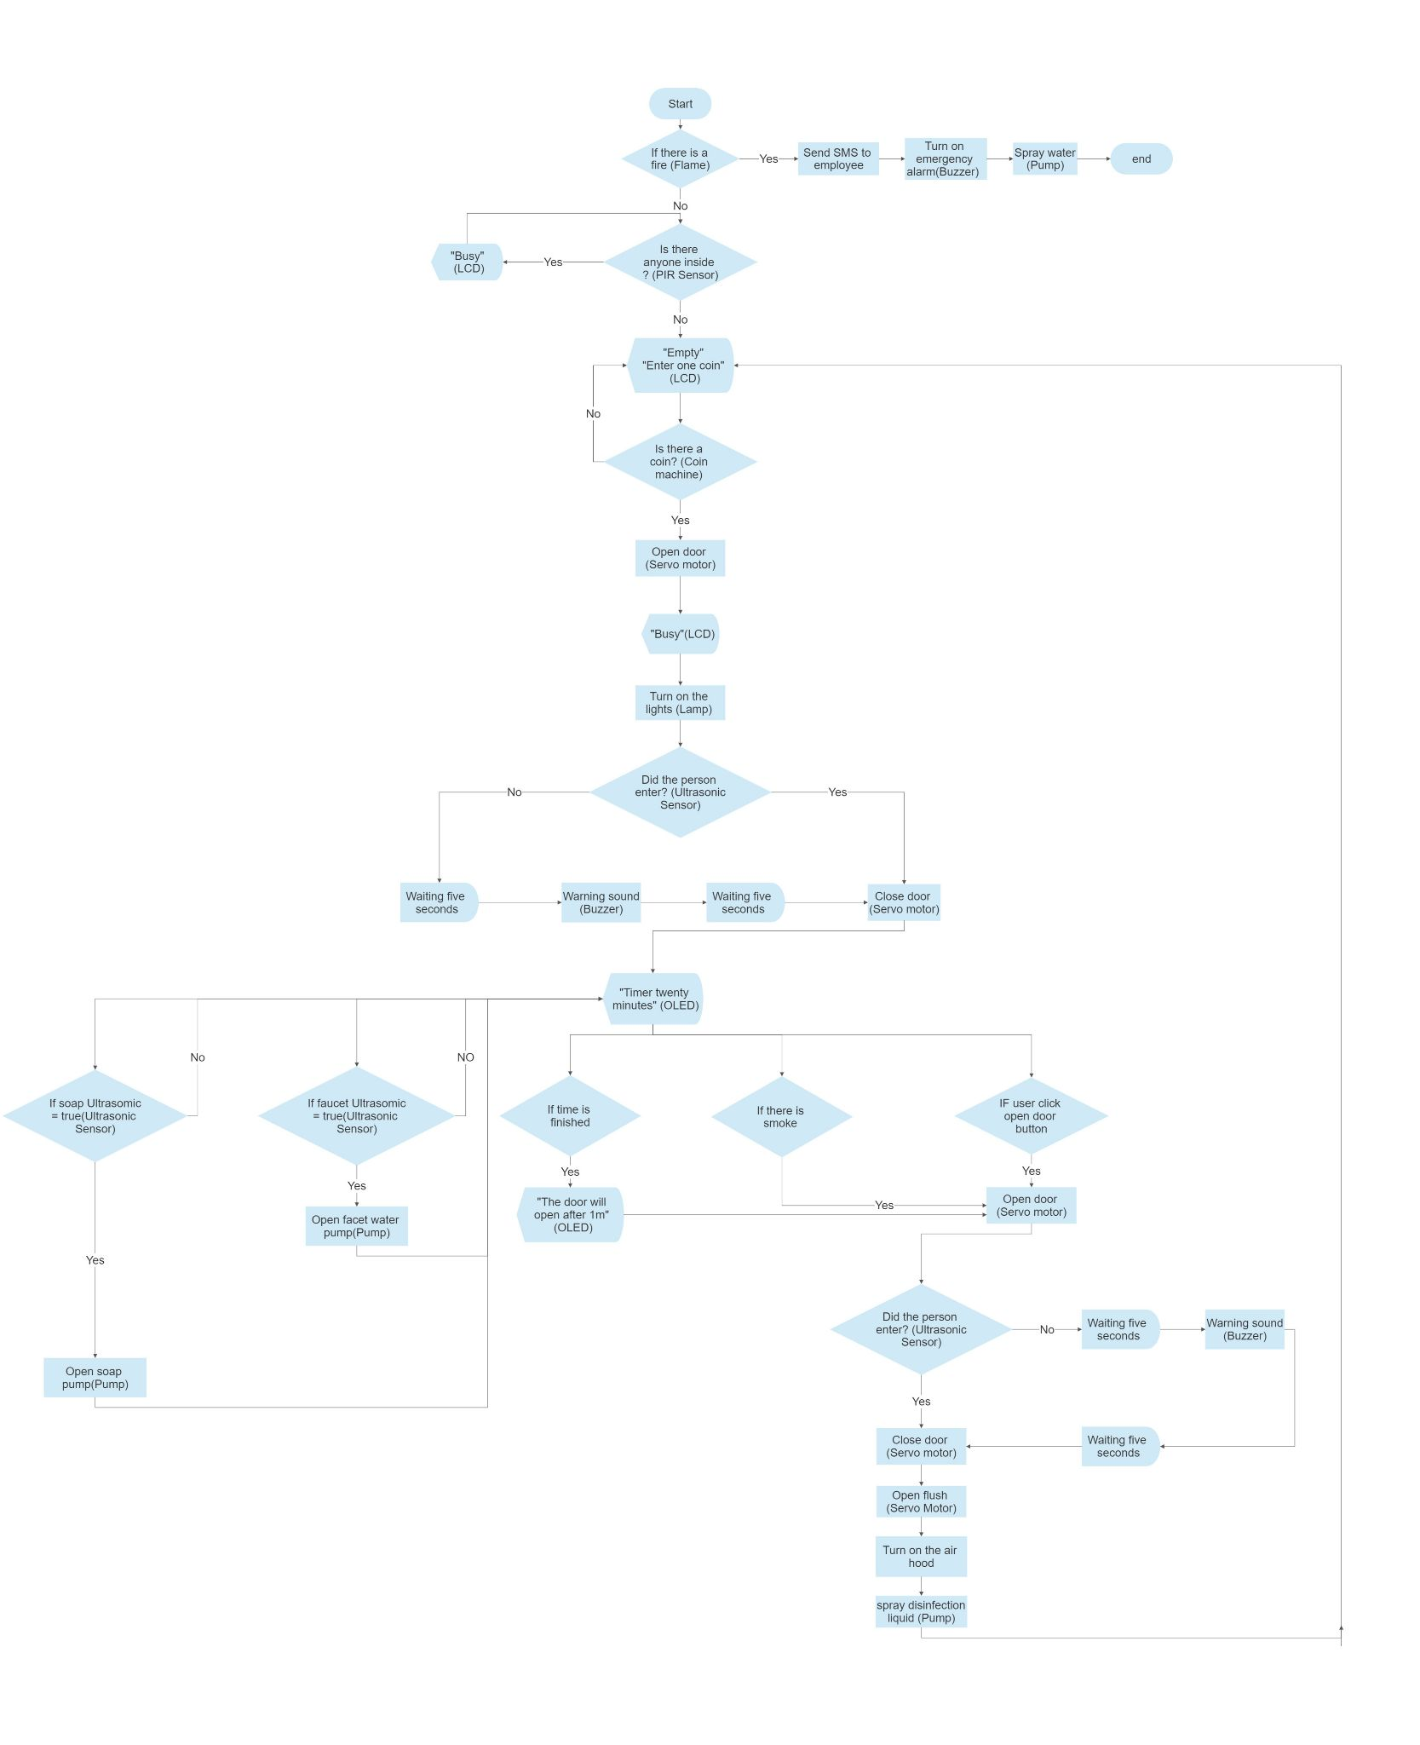
FlowChart

Slide 4


Slide 5
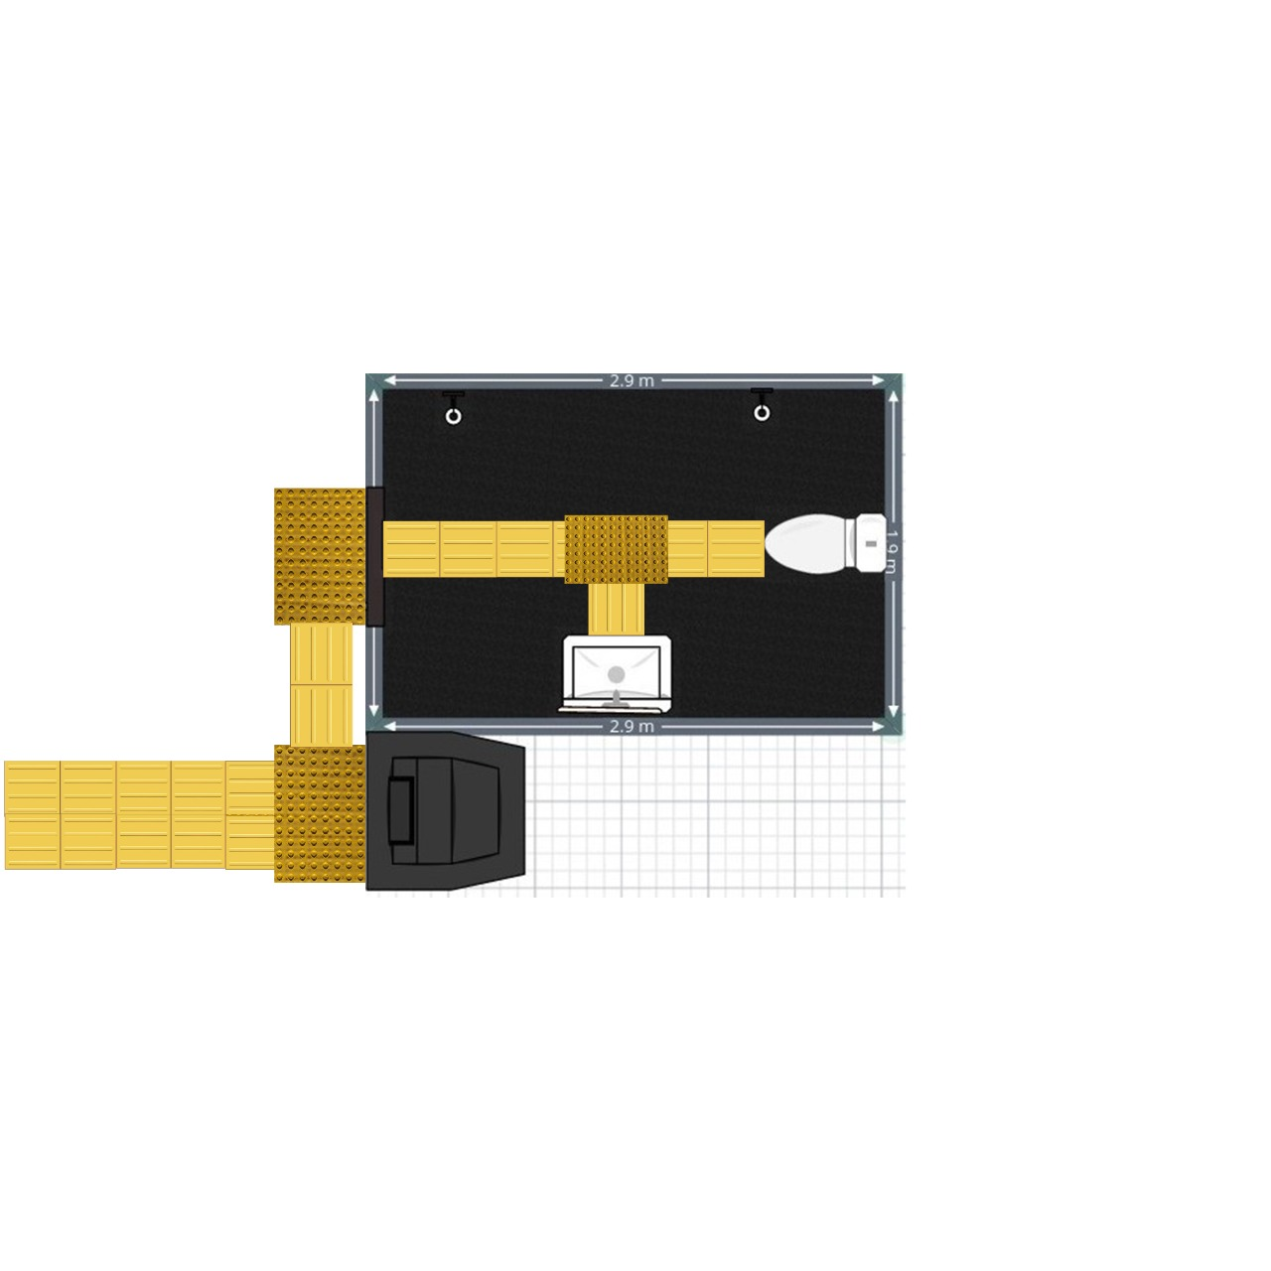

Blind guider in the floor in our 2d design

Slide 6
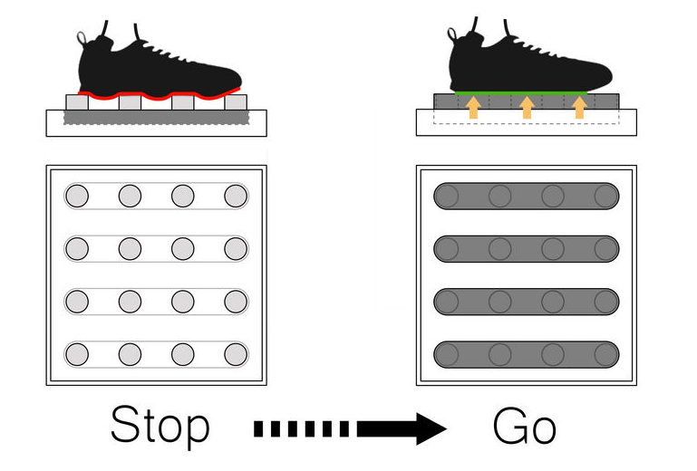

Slide 7
How Project Mechanism
does ?

Slide 8
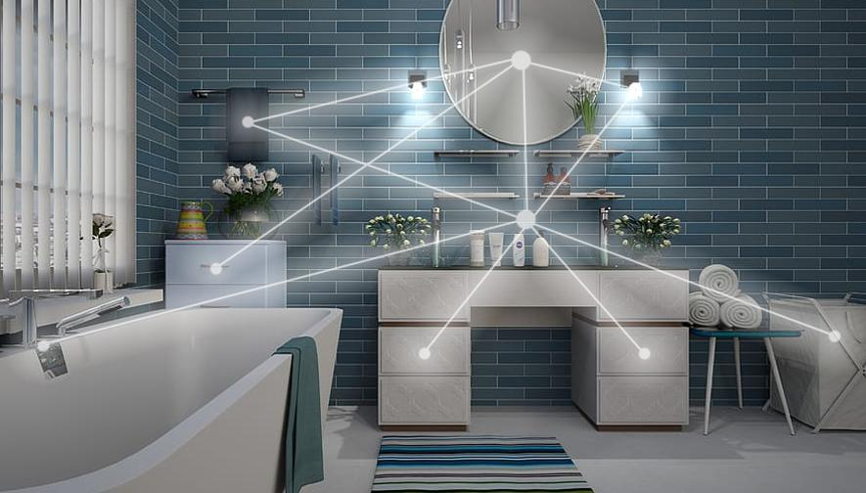
Enter coin .
Door will open automatic.
When you enter the door will close automatic .
Have an smart Toilet and smart tap
Make sure that bathroom is Empty
Automatic washing process after every one

Slide 9
High Security
If happened any problem will send sms to us then will solve it .
Flame Sensor to face any fires
MQ2 Sensor to face any gas or drugs
PIR Sensor to make Sure that bathroom is Empty to Start automatic wash process
…

Slide 10
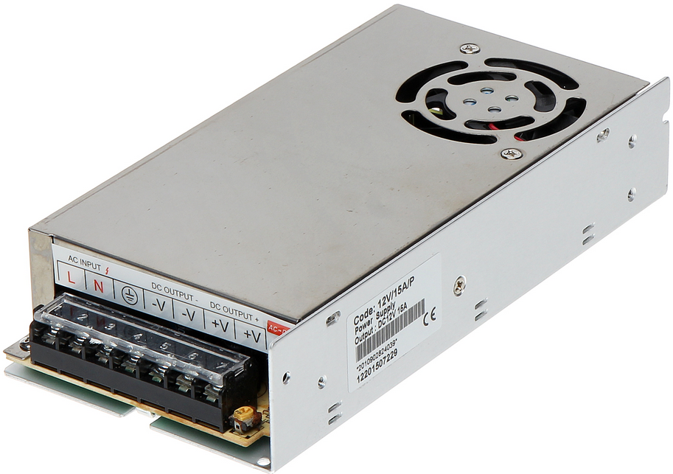
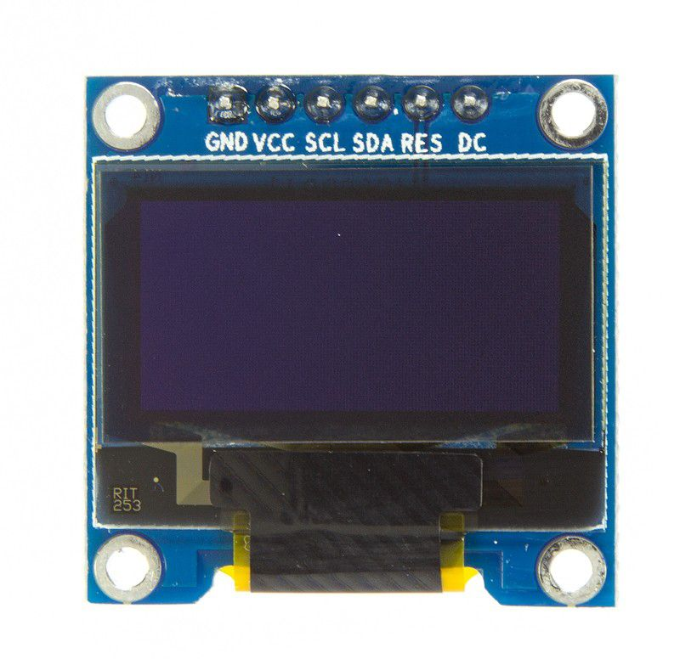
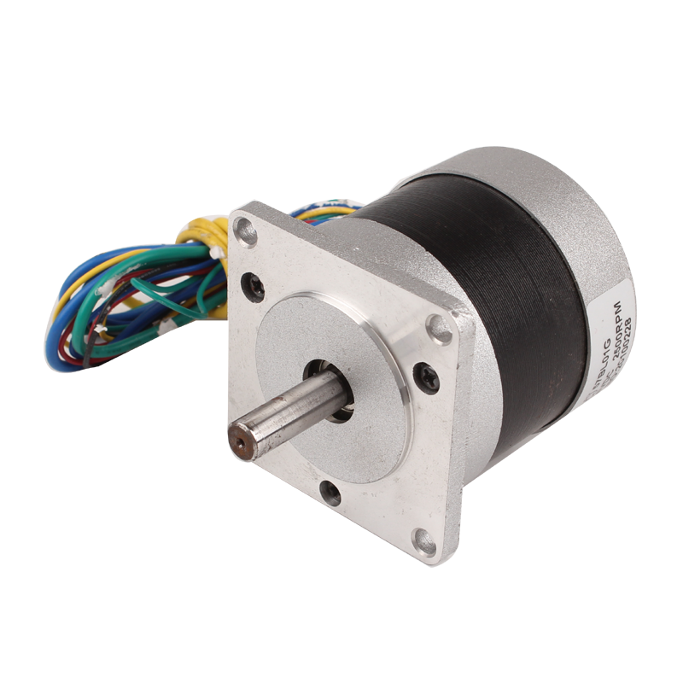
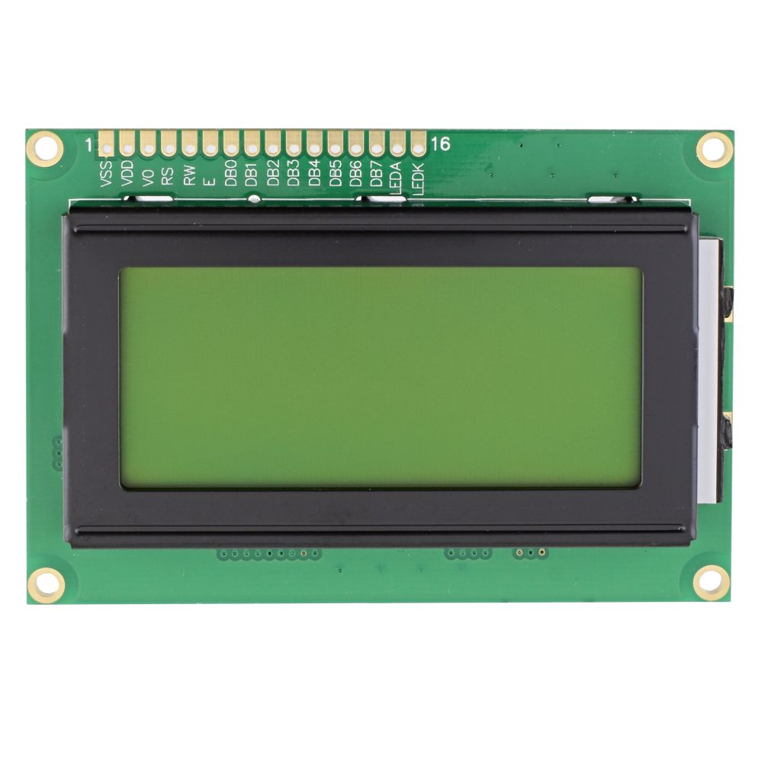
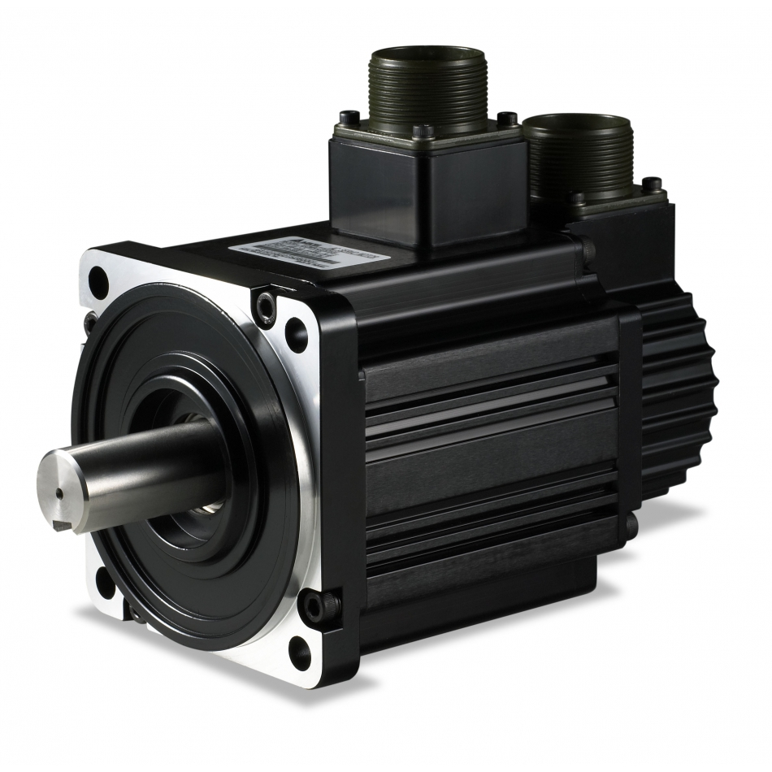
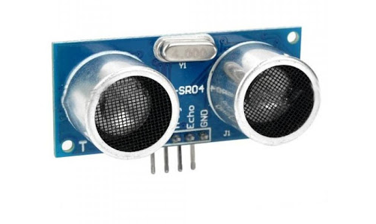
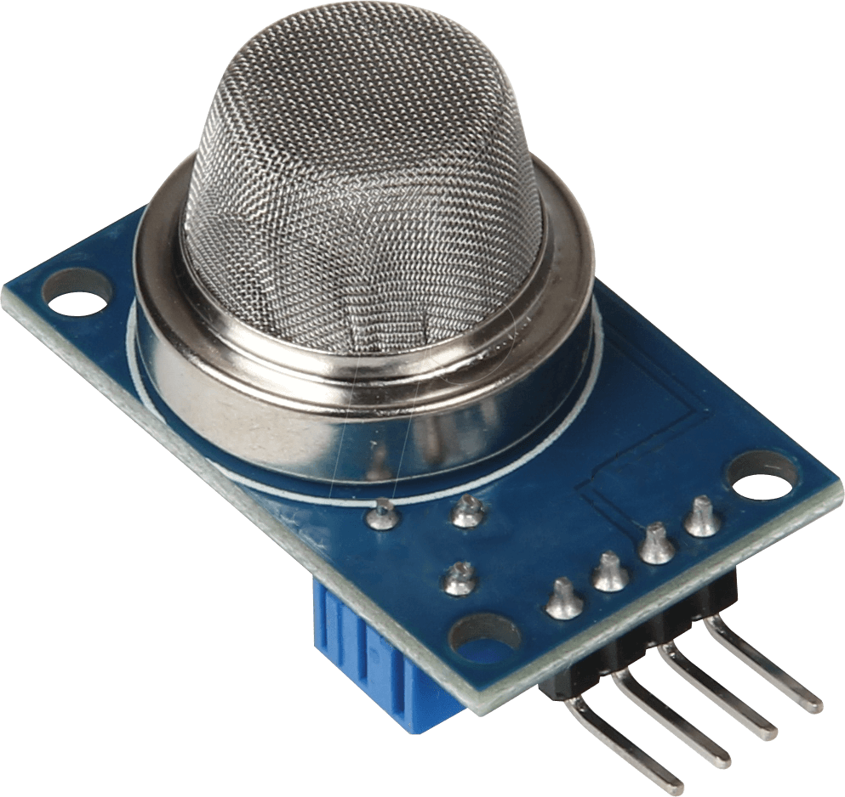
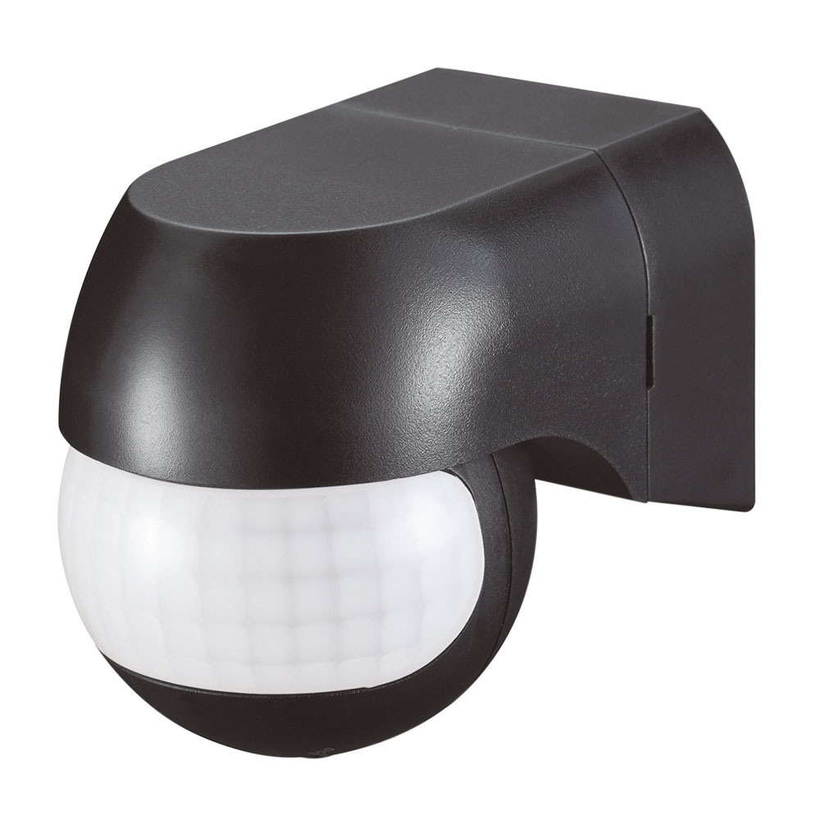

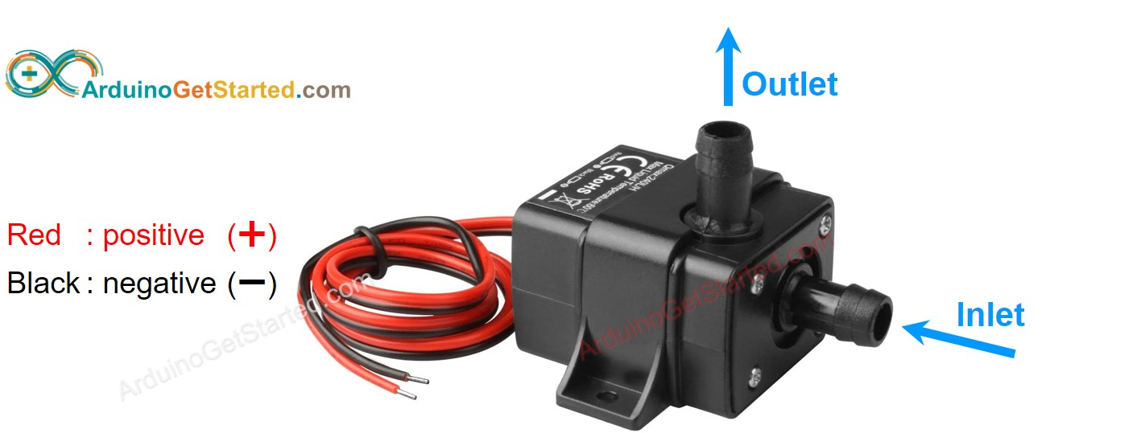
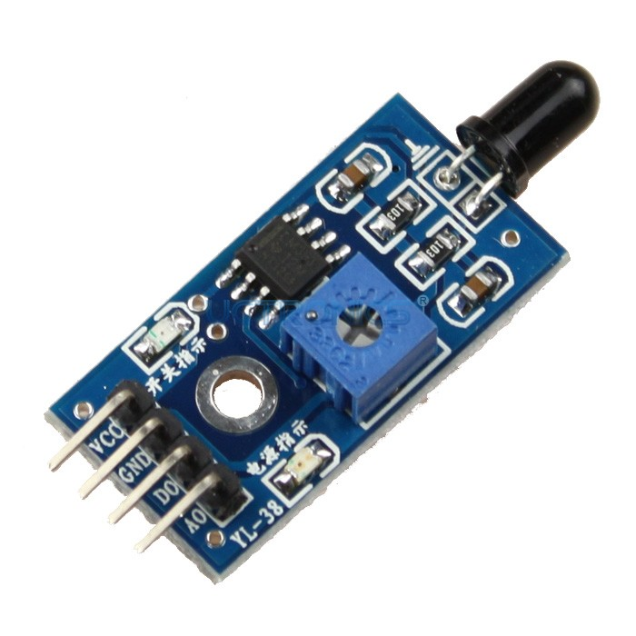
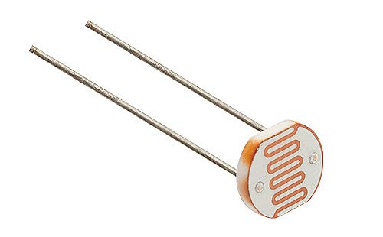
Materials
Power Supply
Servo Motor DC
LCD
OLCD
Ultrasonic Sensors
Servo Motor AC
MQ2 Sensor
Buzzer
PIR Sensor
Flame Sensor
Pumper +Adaptor 12v

Slide 11
Business Model
Click here to get Business Model

Slide 12
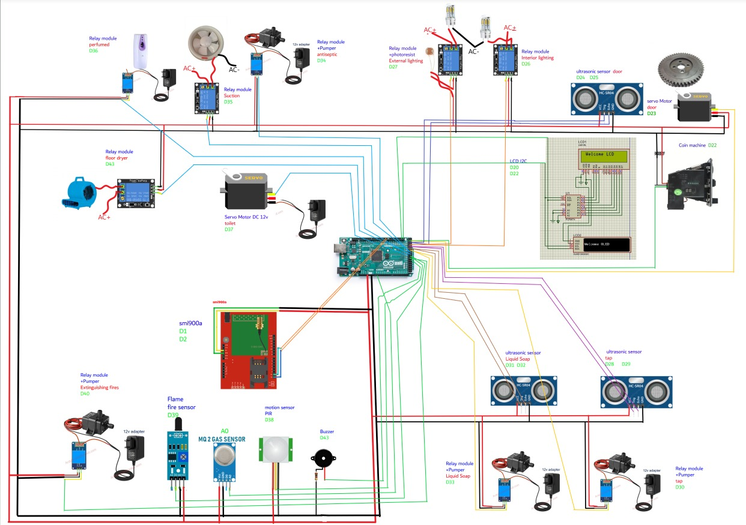
hardware design

Slide 13
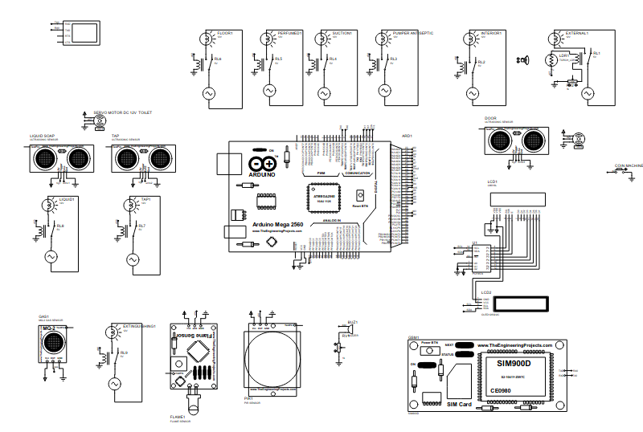
Proteus Design
.

Slide 14
THANKS
Creators ..
Ashraf Elshazly,Ahmed Farouk,Ahmed Andel,Mahmoud Elsalamony,Mahmoud Ayman

